Slide 1

Servlet 3.1
Dima Ionut Daniel

Slide 2
Contents
What is Servlet?
History
Servlet 3.1 new features
Non-Blocking IO
Protocol Upgrade
Large Request/Response data
Security Enhancements
Minor Additions
Servlet 3.1 implementations
Bibliography

Slide 3

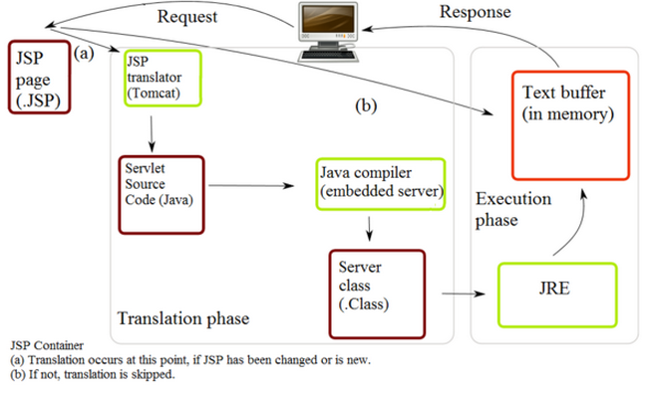
What is Servlet?
A servlet is a Java programming language class that is used to extend the capabilities of servers that host applications accessed by means of a request-response programming model.
Servlets can respond to any type of request, can be used to extend the applications hosted by web servers.

Slide 4
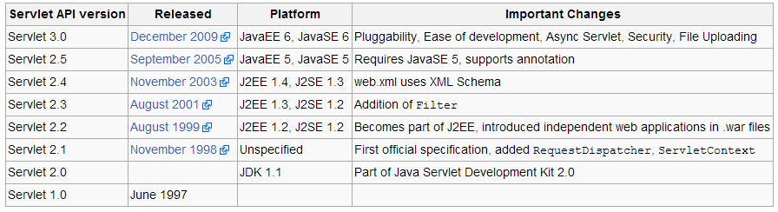
History
The Servlet specification was created by Sun Microsystems, with version 1.0 finalized in June 1997.
Starting with version 2.3, the specification was developed under the Java Community Process.

Slide 5
Servlet 3.1 new features
Non-blocking IO - Servlet 3.0 allowed sync processing, but only traditional I/O was permitted
HTTP protocol upgrade mechanism. An example of opening handshake is WebSocket protocol
New method: HttpServletRequest.upgrade
Added interfaces: javax.servlet.http.HttpUpgradeHandler, javax.servlet.http.WebConnection
Security Enhancements
Applying run-as security roles to #init and #destroy methods.
Session fixation attack by adding HttpServletRequest.changeSessionId and a new interface HttpSessionIdListener.
Miscellaneous
ServletResponse.reset clears any data that exists in the buffer as well as the status code, headers
Relative protocol URL can be specified in HttpServletResponse.sendRedirect
ServletContainerInitializer is independent of metadata-complete and is instantiated per web application

Slide 6
Non-Blocking IO
Non-blocking I/O helps improve the Web Container scalability by increasing the number of connections that can simultaneously be handled by the Web Container by not blocking threads while, for example, reading request data.
Upgrade processing allows a client and server to agree to, and use, a different protocol for future communication.
Large request/response data enables request and response data to exceed 2 GB, thus enabling an application to work with large data.

Slide 7
Non-Blocking IO (cont.)
New APIs added to ServletInputStream, ServletOutputStream.
ServletInputStream:
setReadListener
isFInished
isReady
ServletOutputStream
setWriteListener
canWrite
2 new listeners: ReadListener, WriteListener.

Slide 8
Protocol Upgrade
Upgrade processing allows a conversation, using an agreed communication protocol, between a client and an application resource.
The upgrade handler is registered with the WebContainer and is called to start the new protocol.
The use of non-blocking read is recommended for reading requests from clients.

Slide 9
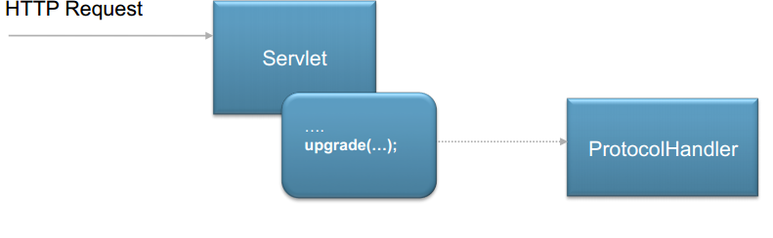
Protocol Upgrade (cont.)
New API added to HttpServletRequest.
public void upgrade(ProtocolHandler handler)
Add new 2 interfaces:
javax.servlet.http.ProtocolHandler
void init(WebConnection wc)
javax.servlet.http.WebConnection
ServletInputStream getInputStream()
ServletOutputStream getOutputStream()

Slide 10
Large Request/Response data
Two new APIs added in Servlet 3.1 enable the content length of request and response data to be represented as a long.
Previously these lengths could only be expressed as integers, limiting their lengths to 2 GB.
Due to existing restrictions in the underlying transport, data must be sent from and to the client in chunks of less than 2 GB.
When sending or receiving such large amount of data it is highly recommended to use non-blocking I/O.

Slide 11
Security Enhancements
For login forms, it is now possible to prevent automatic addition of passwords to a login panel.
For this a new “autocomplete=off” option can be specified in the form html file.
New (**) role configuration option can be used in a security contraint to indicate that any authenticated used is authorized to access the URL pattern.
"deny-uncovered-http-methods" is added to a web.xml and applies to all security constraints in the web.xml.
The WebContainer denies http method requests that are omitted from a security constraint.

Slide 12
Minor Additions
ServletContext.getVirtualServerName() allows access to the configuration name of the logical host on which the server context is deployed.
On any particular host, we can have multiple logical hosts and applications that are distributed among the logical hosts.
HttpServletRequest.changeSessionId() this is partnered with the next one that is a new listener.
With the HttpSessionIdListener, we can be notified whenever the sessionid changed.
With the API, if we don’t like the changes that are made, we can put it back.

Slide 13
Servlet 3.1 implementations
Servlet 3.1 is implemented in Java EE 7 implementation.
Future Java EE 7 implementations:
Glassfish 4
Apache Tomcat 8
Wildfly 8,9,10
Oracle Weblogic 12.X.X
IBM Websphere Application Server 8.x.x.x(Liberty Profile)

Slide 14


Bibliography
http://en.wikipedia.org/wiki/Java_Servlet
http://www.myexpospace.com/JavaOne2012/SessionFiles/CON6793_PDF_6793_0001.pdf

